Slide 1


What is Hadoop?
Hadoop Driven Digital Preservation

Slide 2
Timeline
Dec 2004: Dean/Ghemawat (Google) MapReduce paper
2005: Doug Cutting and Mike Cafarella (Yahoo)
create Hadoop, at first only to extend Nutch
(the name is derived from Doug’s son’s toy elephant)
2006: Yahoo runs Hadoop on 5-20 nodes

Slide 3
Timeline
March 2008: Cloudera founded
July 2008: Hadoop wins TeraByte sort benchmark
(1st time a Java program won this competition)
April 2009: Amazon introduce “Elastic MapReduce”
as a service on S3/EC2
June 2011: Hortonworks founded

Slide 4
Timeline
27 dec 2011: Apache Hadoop release 1.0.0
June 2012: Facebook claim “biggest Hadoop cluster”,
totalling more than 100 PetaBytes in HDFS
2013: Yahoo runs Hadoop on 42,000 nodes,
computing about 500,000 MapReduce jobs per day
15 oct 2013: Apache Hadoop release 2.2.0 (YARN)
This work was partially supported by the SCAPE Project.
The SCAPE project is co‐funded by the European Union under FP7 ICT‐2009.4.1 (Grant Agreement number 270137).

Slide 5
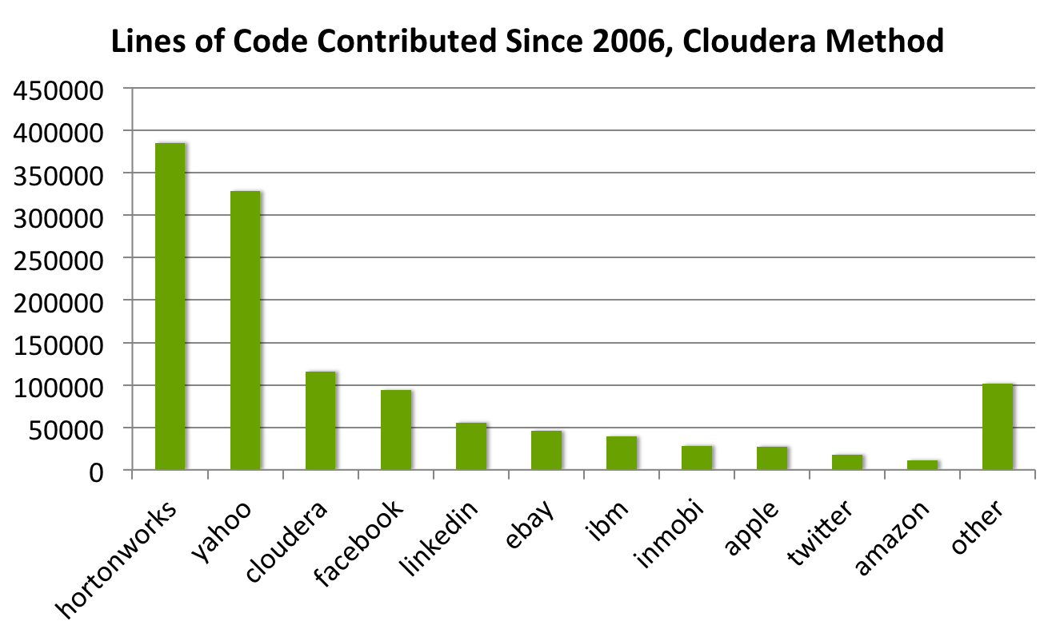
Contributions 2006 - 2011
This work was partially supported by the SCAPE Project.
The SCAPE project is co‐funded by the European Union under FP7 ICT‐2009.4.1 (Grant Agreement number 270137).

Slide 6
“Core” Hadoop
Hadoop Common (formerly Hadoop Core)
Hadoop MapReduce
Hadoop YARN (MapReduce 2.0)
Hadoop Distributed File System (HDFS)
This work was partially supported by the SCAPE Project.
The SCAPE project is co‐funded by the European Union under FP7 ICT‐2009.4.1 (Grant Agreement number 270137).

Slide 7
The wider Hadoop Ecosystem
Ambari, Zookeeper (managing & monitoring)
HBase, Cassandra (database)
Hive, Pig (data warehouse and query language)
Mahout (machine learning)
Chukwa, Avro, Oozie, Giraph, and many more
This work was partially supported by the SCAPE Project.
The SCAPE project is co‐funded by the European Union under FP7 ICT‐2009.4.1 (Grant Agreement number 270137).

Slide 8
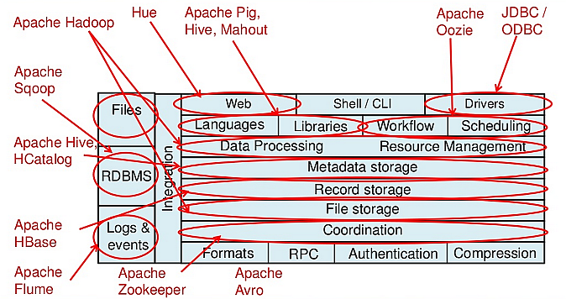
The wider Hadoop Ecosystem
This work was partially supported by the SCAPE Project.
The SCAPE project is co‐funded by the European Union under FP7 ICT‐2009.4.1 (Grant Agreement number 270137).

Slide 9
“Hadoop is a hammer”
“Hadoop is a hammer. Start by figuring out what house
you‘re gonna build.“
Alistair Croll
“If all you have is a hammer, throw away everything
that is not a nail!“
Jimmy Lin
This work was partially supported by the SCAPE Project.
The SCAPE project is co‐funded by the European Union under FP7 ICT‐2009.4.1 (Grant Agreement number 270137).

Slide 10
MapReduce in 41 words (including “library”)
Goal: count the number of books in the library.
Map:
You count up shelf #1, I count up shelf #2.
(The more people we get, the faster this part goes)
Reduce:
We all get together and add up our individual counts.
This work was partially supported by the SCAPE Project.
The SCAPE project is co‐funded by the European Union under FP7 ICT‐2009.4.1 (Grant Agreement number 270137).

Slide 11
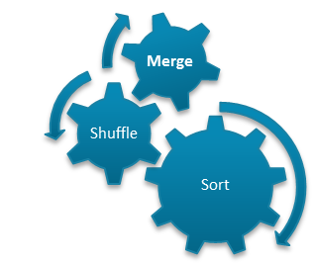
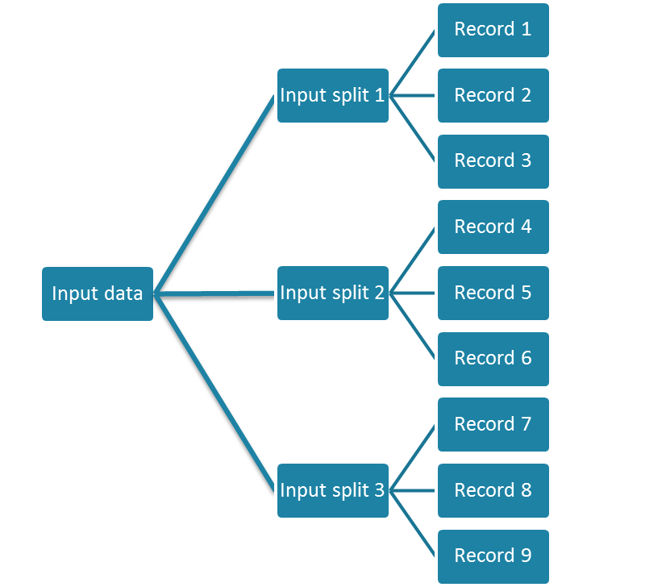
MapReduce in a nutshell
Task1
Aggregated Result
Task 2
Output data
Aggregated Result
Task 3
This work was partially supported by the SCAPE Project.
The SCAPE project is co‐funded by the European Union under FP7 ICT‐2009.4.1 (Grant Agreement number 270137).

Slide 12
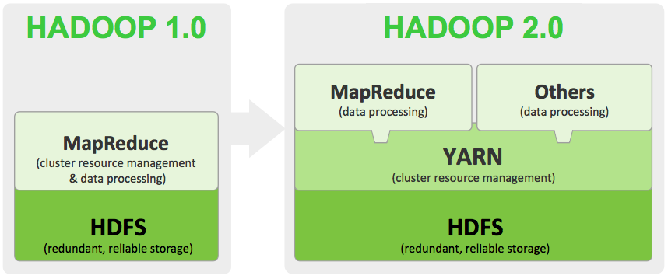
MapReduce vs YARN
This work was partially supported by the SCAPE Project.
The SCAPE project is co‐funded by the European Union under FP7 ICT‐2009.4.1 (Grant Agreement number 270137).

Slide 13
When to use Hadoop?
Generally, always when “standard tools” don’t work anymore because of sheer data size
(rule of thumb: if your data fits on a regular hard drive, your better off sticking to Python/SQL/Bash/etc.!)
Aggregation across large data sets: use the power of Reducers!
Large-scale ETL operations (extract, transform, load)
This work was partially supported by the SCAPE Project.
The SCAPE project is co‐funded by the European Union under FP7 ICT‐2009.4.1 (Grant Agreement number 270137).

Slide 14

Reading
Tom White: Hadoop. The Definitive Guide
(get 3rd ed. for extra YARN chapter)
YARN explained (really quite well):
http://blog.cloudera.com/blog/2012/02/mapreduce-2-0-in-hadoop-0-23/
Jimmy Lin: Text Processing with MapReduce:
http://lintool.github.io/MapReduceAlgorithms/ed1n.html
This work was partially supported by the SCAPE Project.
The SCAPE project is co‐funded by the European Union under FP7 ICT‐2009.4.1 (Grant Agreement number 270137).

